Slide 1
Proposal paper
DCTV :Dynamically Controlled Traffic lights using VAE and custom loss

Slide 2
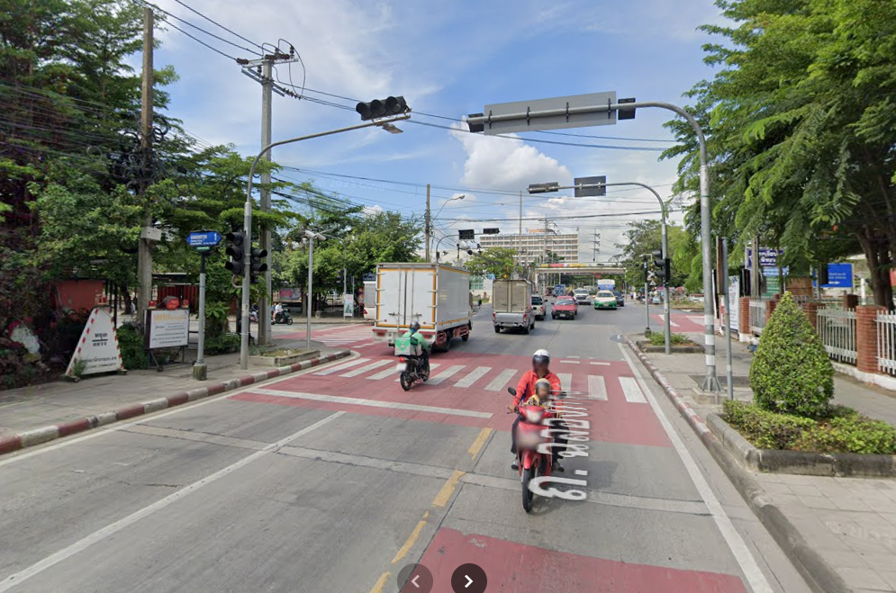
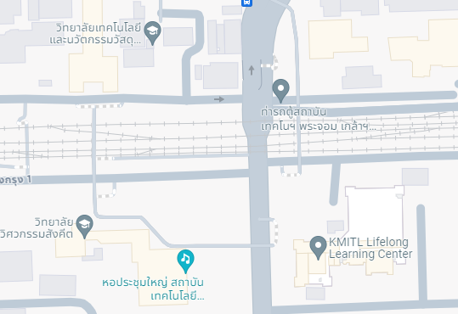
Problem
Location: Chalong Krung 1 Alley
The traffic light cannot be use due to unfavorable limitations that limit the use of it manually. If it's used it might create more traffic jams than not using it.

Slide 3
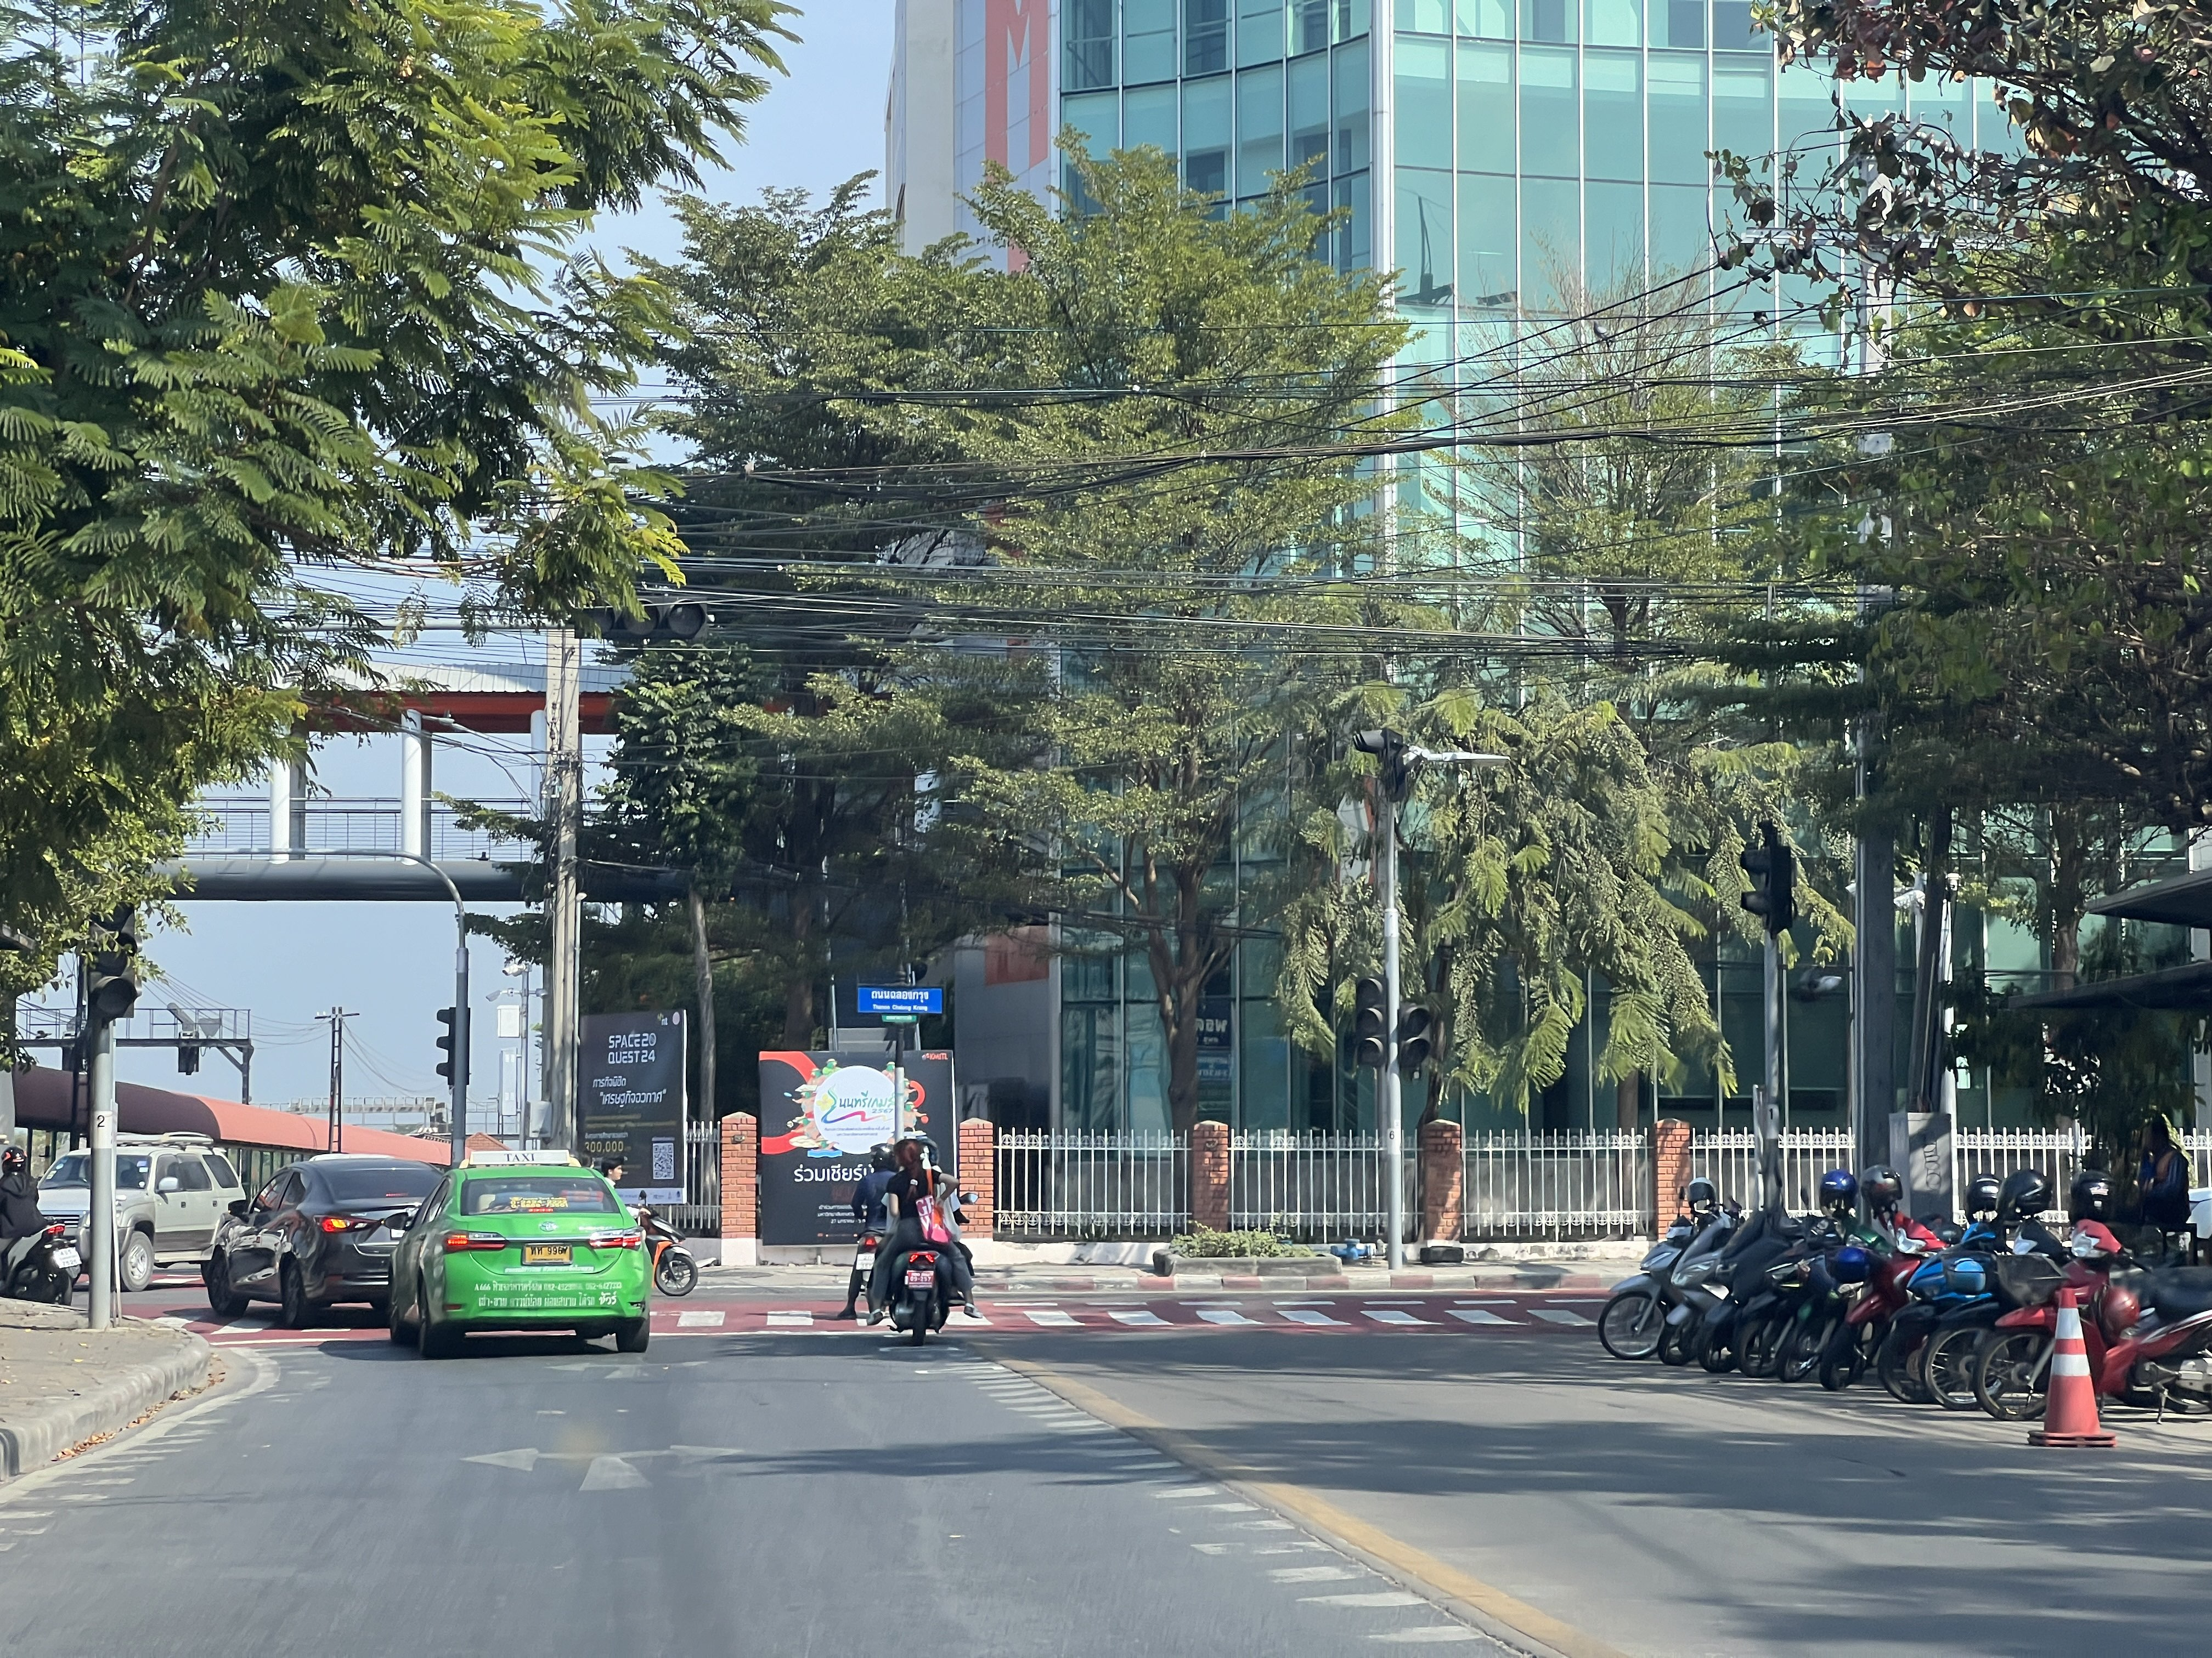
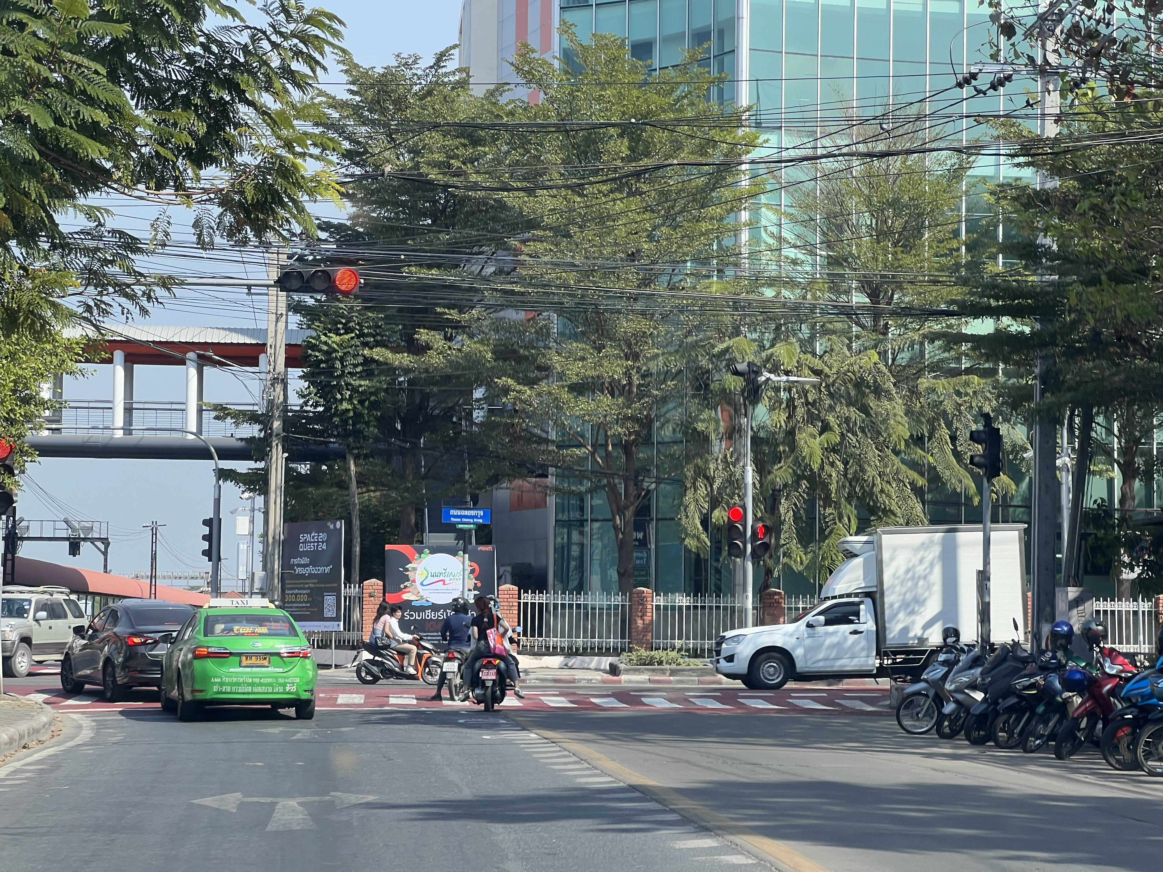
Problem

Slide 4
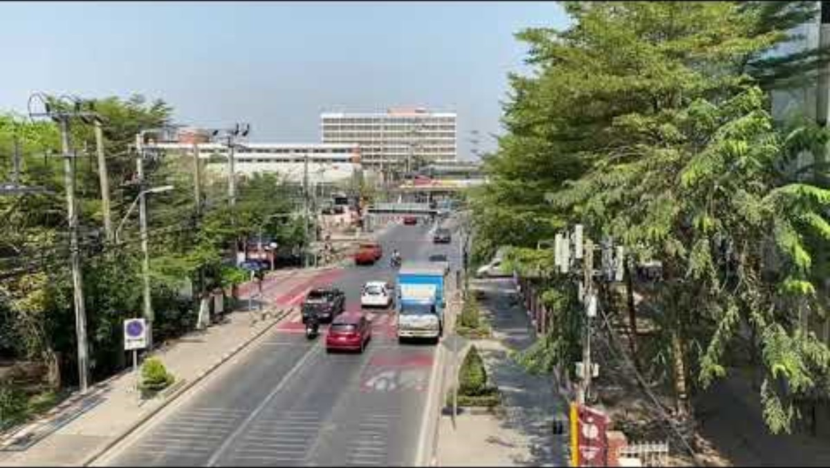
Problem

Slide 5
Scope

Slide 6
Scope
Rest & Passing by trains
Train Schedule
Junction traffic
Traffic light time
Traffic flow
Date/Time event schedule

Slide 7
Rest & Passing by trains
Train REST at Pra Chom Klao and/or Hua Takhe Station (Passenger train)
The system will estimate dwell times (1 minute including potential delays of max 30 minutes) for passenger trains resting at Pra Chom Klao and Hua Takhe station
Traffic lights will be dynamically controlled to facilitate smooth traffic flow before, during, and after train stops.
Train PASSING by Pra Chom Klao Station (Freight train)
The model will detect freight trains passing through the station without stopping, adjusting traffic signals to minimize disruption.

Slide 8
Train Schedule
Data Source:
The project will interface with the official train timetable from www.railway.co.th to obtain train schedule (actual arrival/depart time and passing by time) for the Pra Chom Klao and Hua Takhe station.
Data Extraction and Updates:
The system will implement a method (e.g., web scraping or API utilization, if available) to regularly extract relevant train timetable data and update the model accordingly.

Slide 9
Train Schedule
Timetable Integration:
Arrival/Departure and Pass-By times obtained from the website will be used to dynamically adjust traffic signals.
This will prioritize traffic flow adjustments in advance of train arrivals and departures, minimizing traffic disruptions.
Delay Handling:
The system will incorporate a mechanism to handle potential train delays.
This could include:
Real-time updates: Monitoring live updates from the railway website, if available.
Delay Tolerance: Building in a buffer time to account for common delays.

Slide 10
Junction traffic
Traffic Data Collection:
The system will utilize a combination of sensors (e.g., video cameras, inductive loop detectors) to collect real-time traffic data at the "Pra Jom Klao" intersection.
Collected data will include:
Vehicle counts per lane
Queue lengths in each direction
Traffic density estimates

Slide 11
Junction traffic
Traffic Flow Analysis:
The VAE (Variational Autoencoder) model will analyze traffic data to identify underlying patterns and trends in traffic flow.
The Transformer-based model will focus on predicting short-term traffic demand and potential congestion hotspots.
***The system will explicitly model turning movements (left, right, straight) at the junction to enable more precise traffic control.***

Slide 12
Junction traffic
Traffic Signal Control:
A reinforcement learning algorithm will be used to dynamically optimize traffic signal timings (green phase durations, cycle time) based on real-time traffic conditions.
The system will adapt signal timings to minimize overall vehicle delay and maximize traffic throughput.
Prioritization mechanisms will be implemented for emergency vehicles and potentially public transit, depending on project requirements.

Slide 13
Junction traffic
Performance Evaluation:
The system's performance will be evaluated using the following metrics:
Average vehicle delay
Intersection throughput
Queue lengths
Potential reduction in fuel consumption and emissions (if data is available)
A traffic simulation environment will be used for initial testing and evaluation before real-world deployment.

Slide 14
Traffic light time
Dynamic Timing:
Traffic light phase durations (green, yellow, red) will not be fixed. Instead, they will be dynamically determined by the traffic control system.
Real-Time Optimization:
The VAE and Transformer models, in conjunction with a suitable optimization algorithm (e.g., reinforcement learning), will calculate optimal signal timings based on
the following factors:
Real-time traffic density and flow patterns
Train arrival and departure times from the integrated timetable
Pedestrian volumes (if pedestrian crossing times are integrated)
Priority rules (e.g., emergency vehicle passage)

Slide 15
Traffic light time
Cycle Time Flexibility:
The overall cycle time (time for a complete sequence of all signal phases) will be flexible. The system will adjust it to best match traffic demand and prevent unnecessary idling.
Constraints:
To ensure safety and operational requirements, the scope will include
the following constraints:
Default green times for each phase
Maximum total cycle length
Provisions for pedestrian crossing times (if applicable)

Slide 16
Traffic flow
Traffic Modeling:
The VAE and Transformer models will work together to:
- Characterize traffic flow patterns, including volume fluctuations throughout the day.
- Identify bottlenecks and congestion points in real-time.
- Predict short-term changes in traffic demand based on historical trends, train schedules, and real-time observations.

Slide 17
Traffic flow
Optimization Focus:
The primary goal of traffic flow analysis is to enable the traffic light control system to make proactive decisions.
This will help:
Minimize average vehicle delays.
Increase throughput through the intersection.
Prevent the buildup of excessive queues, particularly in directions impacted by train crossings.

Slide 18
Date/Time event schedule
Data Source:
The project will interface with the official event timetable from www.osda.kmitl.ac.th to obtain event schedule.
Timetable Integration:
This will prioritize traffic flow adjustments in advance of event schedule and minimizing traffic disruptions

Slide 19
Objective

Slide 20
Objective
Optimize Traffic Flow:
Reduce average vehicle delay at the "Pra Jom Klao" intersection.
Increase vehicle throughput during peak hours.
Minimize the formation of excessive queues, particularly due to train crossings. Dynamic
Traffic Signal Control:
Develop a traffic light system that intelligently adapts its timings based on real-time traffic flow, train schedules, and potentially other factors (e.g., emergency vehicle detection).
Demonstrate an improvement in performance (using established metrics) when compared to traditional fixed-time or basic pre-timed traffic signals.
Predictive Traffic Modeling:
Build a combined VAE and Transformer model to analyze traffic patterns and forecast short-term traffic demands.
Evaluate the model's accuracy with metrics relevant to your chosen traffic flow representation.

Slide 21
Past five to six years of recent research paper

Slide 22
Paper name | Publisher | Date
Encing Traffic Flow Prediction using Outlier-Weighted AutoEncoders: Handling Real-Time Changes | Himanshu C. , Marwan H. | 27 Dec 2023
Diffusion Convolutional Recurrent Neural Network: Data-Driven Traffic Forecasting | Yaguang L. , Rose Y. , Cyrus S., Yan L. | 22 Feb 2018
Decoupled Dynamic Spatial-Temporal Graph Neural Network for Traffic Forecasting | Zezhi Shao, Zhao Zhang, Wei Wei, Fei Wang, Yongjun Xu, Xin Cao, Christian S. Jensen | 5 Sep 2022
A Survey on Graph Neural Networks in Intelligent Transportation Systems | Hourun Li, Yusheng Zhao, Zhengyang Mao, Yifang Qin, Zhiping Xiao, Jiaqi Feng, Yiyang Gu, Wei Ju, Xiao Luo, Ming Zhang | 2 Jan 2024
Online Test-Time Adaptation of Spatial-Temporal Traffic Flow Forecasting | Pengxin Guo, Pengrong Jin, Ziyue Li, Lei Bai, and Yu Zhang | 8 Jan 2024
Large-scale Mixed Traffic Control Using Dynamic Vehicle Routing and Privacy-Preserving Crowdsourcing | Dawei Wang, Weizi Li, Jia Pan | 19 Nov 2023

Slide 23
Paper name | publisher | Date
Towards a Distributed and Infrastructure-less Vehicular Traffic Management System | demar T. Akabanea , Roger Immicha , Luiz F. Bittencourta , Edmundo R. M. Madeiraa , Leandro A. Villas | 10 Feb 2020
Transfer Learning and Online Learning for Traffic Forecasting under Different Data Availability Conditions: Alternatives and Pitfalls | Eric L. Manibardo , Ibai Lana , and Javier Del Ser | 8 May 2020
Interactive Physics-Inspired Traffic Congestion Management | Hossein Rastgoftar | 26 Jun 2019
Deep Reinforcement Learning for Adaptive Traffic Signal Control | Kai Liang Tan , Subhadipto Poddar , Subhadipto Poddar , Anuj Sharma | 14 Nov 2019
Urban flows prediction from spatial-temporal data using machine learning: A survey | Peng Xie, Tianrui Li, Jia Liu, Shengdong Du, Xin Yang, Junbo Zhang | 26 Aug 2019
Deep Reinforcement Learning for Intelligent Transportation Systems | Xiao-Yang Liu, Zihan Ding, Sem Borst, Anwar Walid | 3 Dec 2018

Slide 24
Methodology

Slide 25
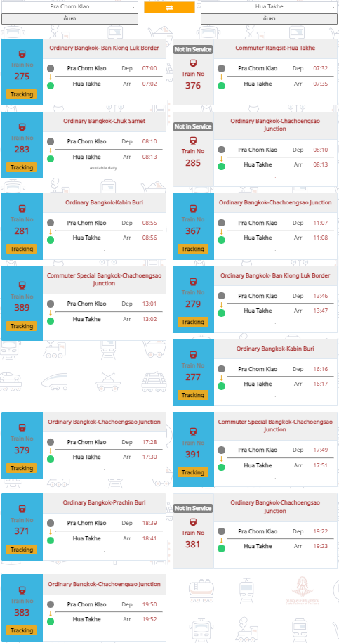
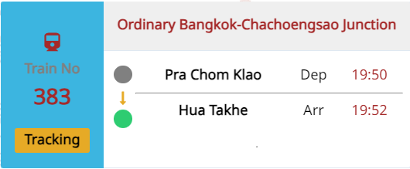
Dataset – Passenger/Freight train Data
Passenger train (stop at Pla Chom Klao Station)
Train schedule from Pra Chom Klao to Hua Takhe and Hua Takhe to Pra Chom Klao
The closet departure time of the train that is active compared to the current time

Slide 26
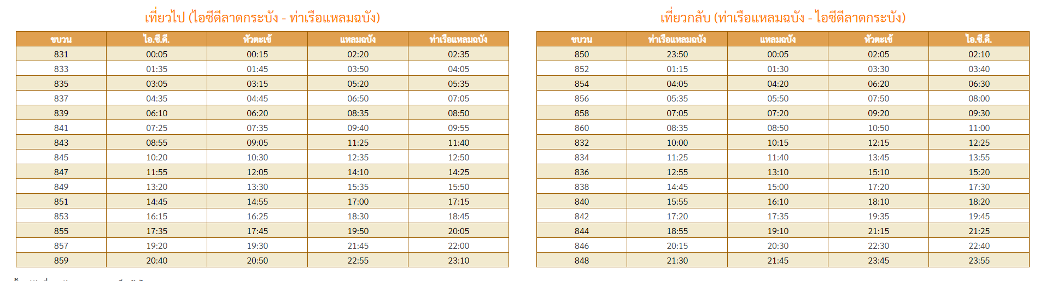
Dataset – Passenger/Freight train Data
Freight train (do not stop at Pla Chom Klao Station)
Train schedule of freight trains which are pass the junction during the day time
Choose 2 routes which pass Pla Chom Klao station, and focusing on time table between ICD and Hua Takhe station

Slide 27
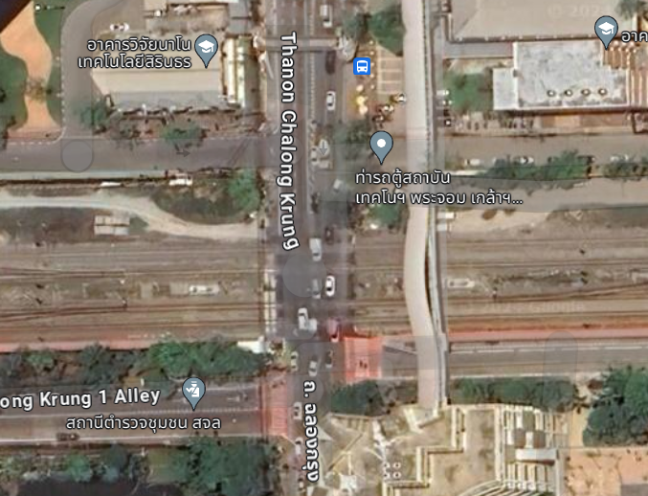
Dataset – Traffic & Environmental data
Necessary parameters for traffic management
Junction Parameters
Density of vehicle for each lane
2
Vehicle's entrance rate for each lane
Vehicle's release rate for each lane
Environment Parameters
Nearby event
3
Current date and time
1
4

Slide 28
Architecture
Input Features
Variational Auto Encoder
Mimic Input
Sample
Latent Space
Encoder
Decoder
Reconstruction loss
Features * num of lane
Output (traffic plan)
Selecting kernel
Scaling kernel
Sample
Latent Space
Positional Encoder
Possible solutions
Vehicle's average waiting time loss
Selecting error
Scaling error
num of lane

Slide 29
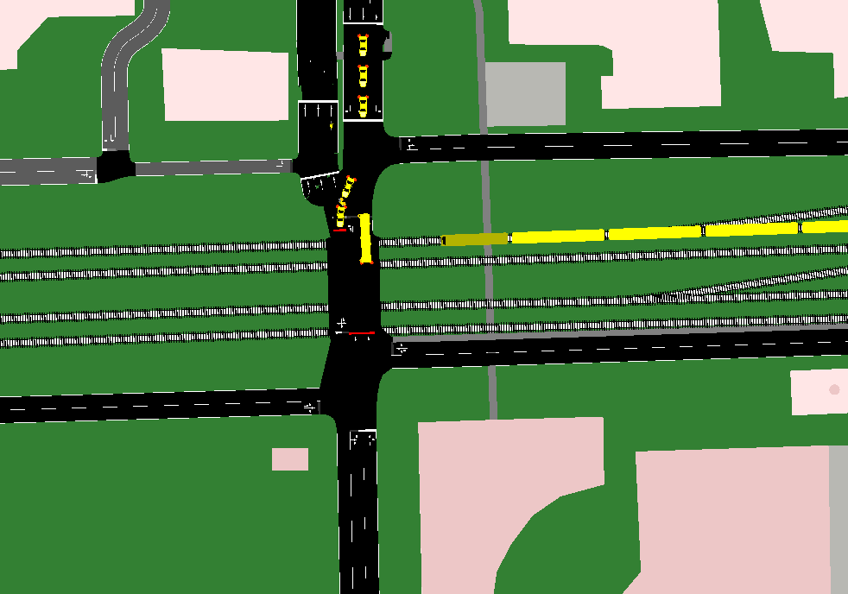
Result Evaluation – Simulation test
Simulation Tool: We utilized SUMO (Simulation of Urban Mobility), a powerful open-source traffic microsimulation platform, to model the real-world conditions of the “Pra Jom Klao” intersection and surrounding roadways.
Python-Based Integration: A Python interface was developed to enable bidirectional communication between SUMO and our VAE/Transformer-based traffic control model.
Iterative Evaluation: Our evaluation follows an iterative loop:
1. Current traffic state information is extracted from SUMO.
2.Our model analyzes the data and determines optimized traffic light timings.
3.Python updates the SUMO simulation with the new timings.

Slide 30
Possible registration

Slide 31
Listing from most preferable
Name | Topics
CPS AIPE 2024 : CPS--2024 2nd International Conference on Artificial Intelligence and Power Engineering (AIPE 2024) (Submission Deadline Jun 10, 2024) | Neural Networks Machine Learning
IEEE WAIE 2024 : IEEE--2024 6th International Workshop on Artificial Intelligence and Education (Submission Deadline May 25, 2024) | Artificial Intelligence and Open Learning
CCVPR 2024 : 2024 International Joint Conference on Computer Vision and Pattern Recognition (Submission Deadline Jul 10, 2024) | Ensemble Learning Algorithms
MIWAI 2024 : 17th Multi-Disciplinary International Conference on Artificial Intelligence (Submission Deadline Jul 1, 2024) | Machine Learning

Slide 32
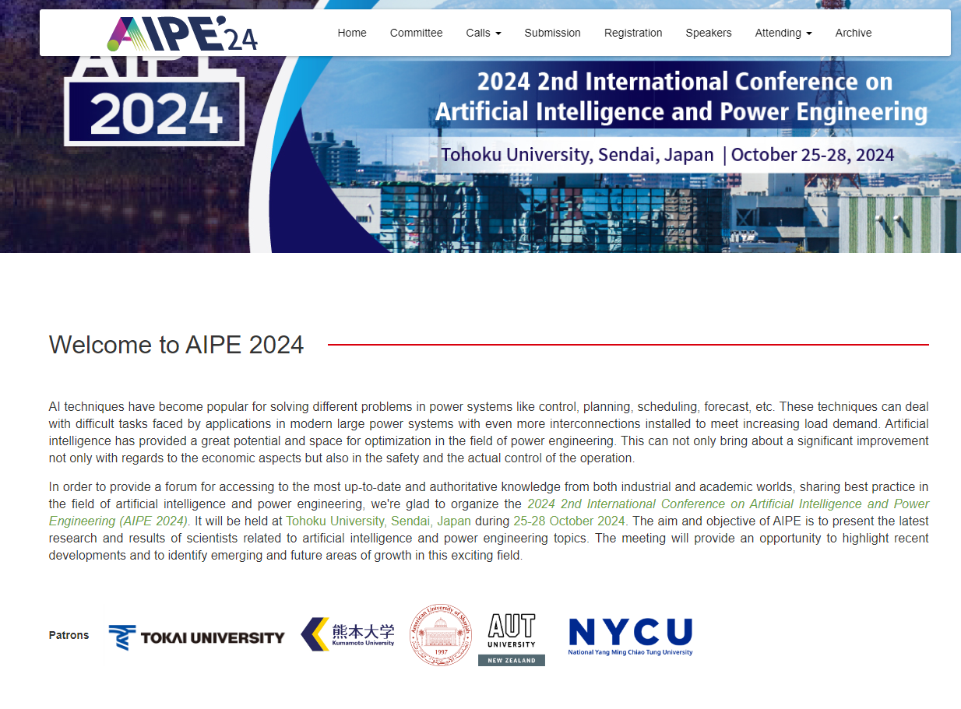
CPS AIPE 2024 : CPS--2024 2nd International Conference on Artificial Intelligence and Power Engineering
Topics
Machine Learning
Neural Networks
Place
Tohoku University, Sendai, Japan
Submission deadline
Jun 10 , 2024
Event date
Oct 25 ,2024 – Oct 28, 2024
Registration price
Student before Aug 5th : 490 USD
Student after Aug 5th : 500 USD
Indexing
Scopus, Ei Compendex and
Other major databases.

Slide 33
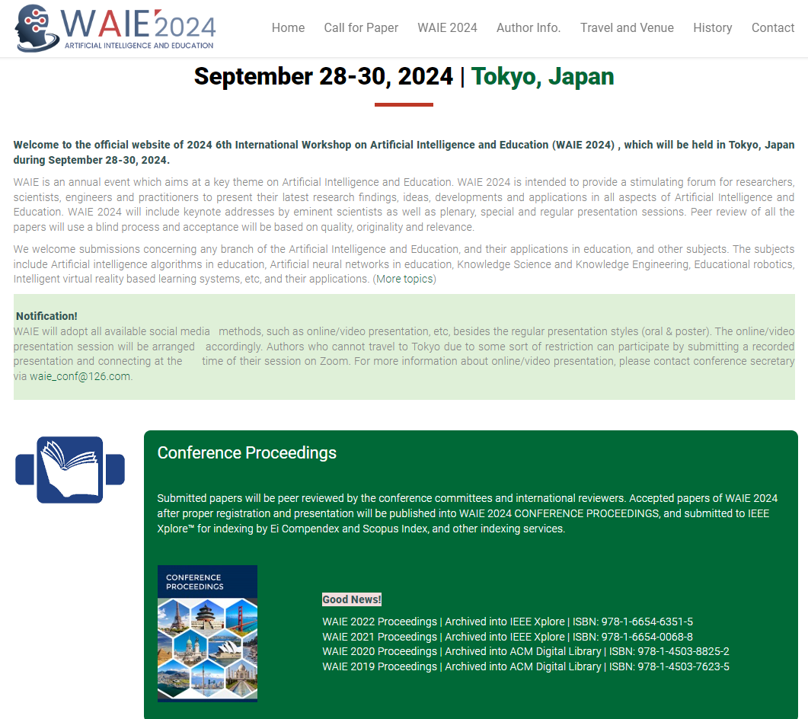
IEEE WAIE 2024 : IEEE--2024 6th International Workshop on Artificial Intelligence and Education
Topics
Artificial Intelligence and Open Learning
Place
TKP conference Center, Tokyo, Japan
Submission deadline
May 25, 2024
Event date
Sep 28,2024 – Sep 30, 2024
Registration price
Student before June 10th : 500 USD
Student after June 10th : 550 USD
Indexing
IEEE Xplore™ for indexing by Ei Compendex
and Scopus Index, and other indexing services.

Slide 34
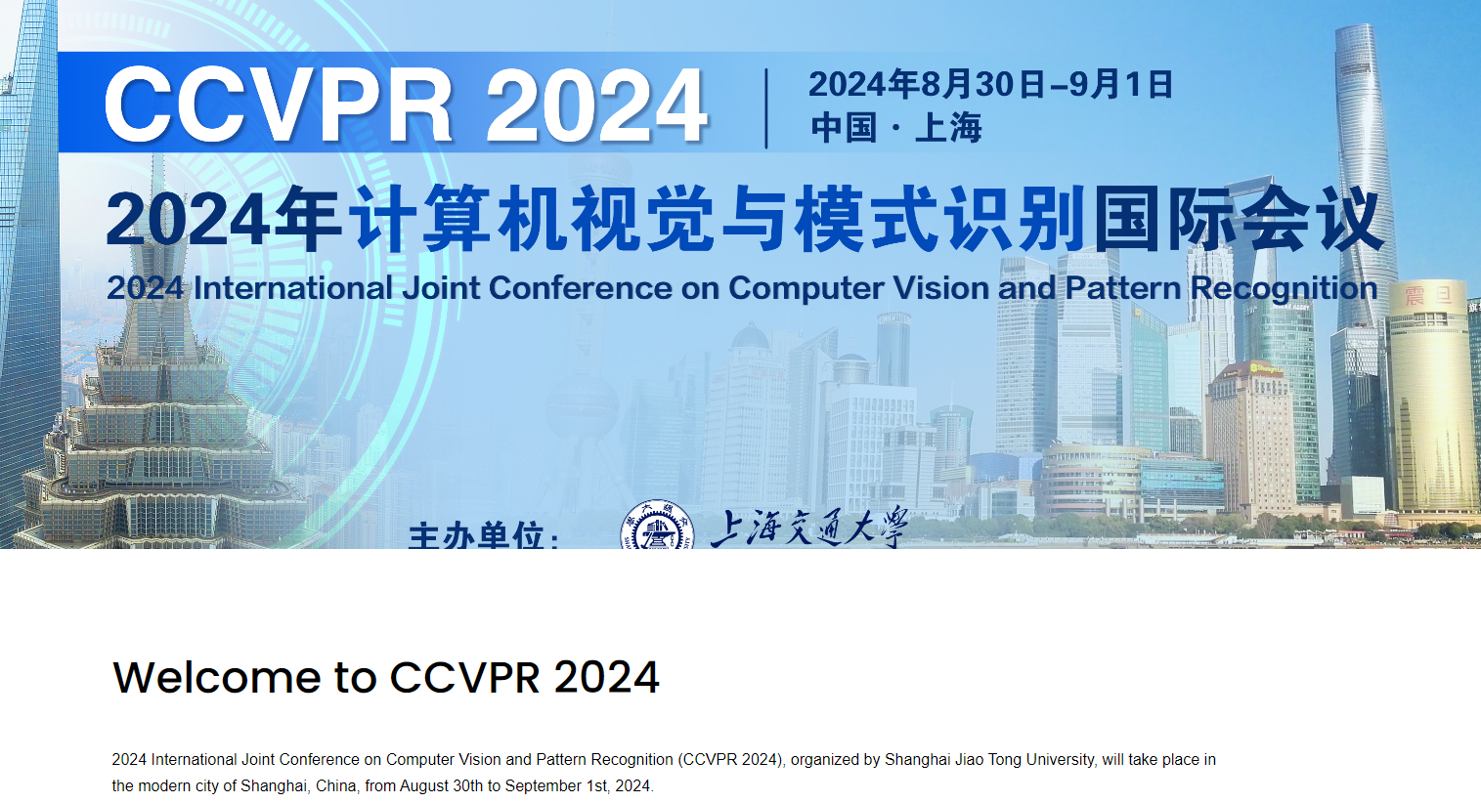
CCVPR 2024 : 2024 International Joint Conference on Computer Vision and Pattern Recognition
Topics
Ensemble Learning Algorithms
Place
Shanghai, China
Submission deadline
Jul 19, 2024
Event date
Aug 30,2024 – Sep 1, 2024
Registration price
Student before May 30th : 450 USD
Student after May 31st – Aug 29th : 500 USD
Indexing
Ei Compendex, Scopus, CPCI, Google Scholar etc

Slide 35
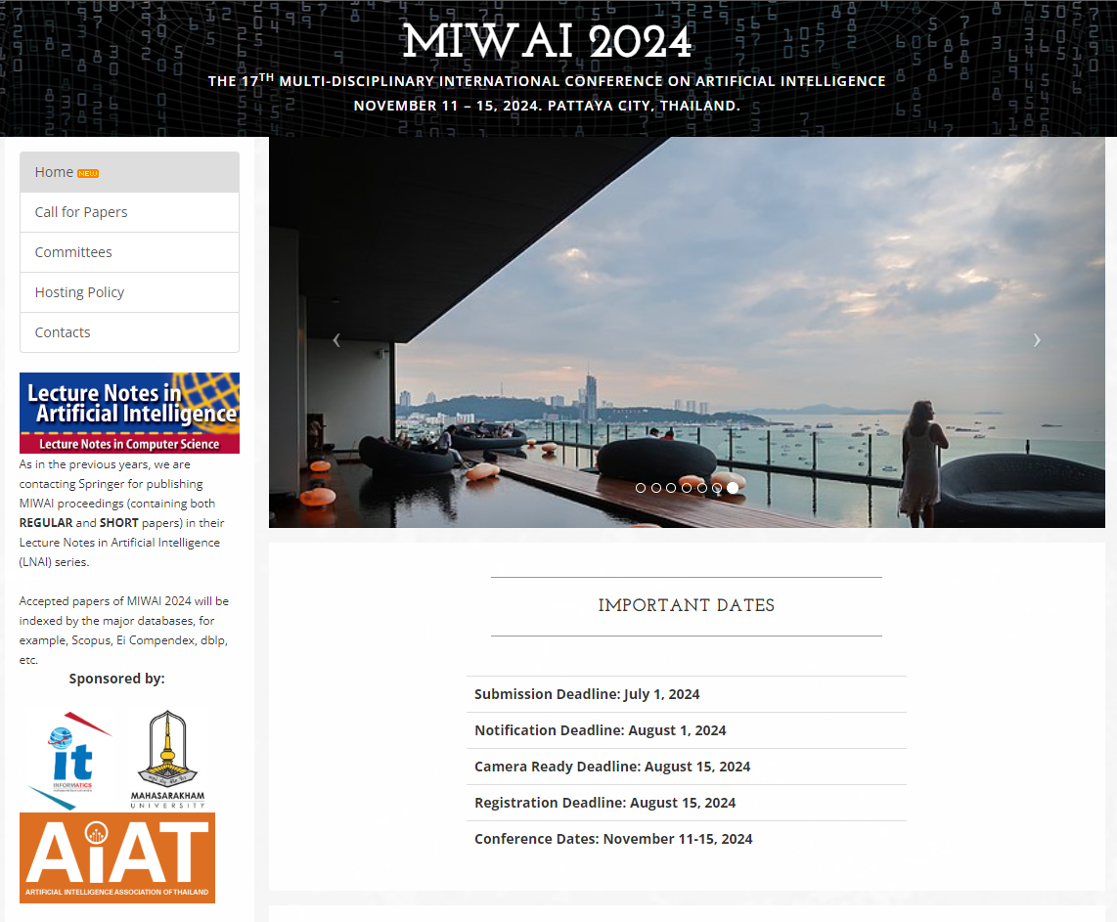
MIWAI 2024 : 17th Multi-Disciplinary International Conference on Artificial Intelligence
Topics
Machine Learning
Place
PATTAYA CITY, Thailand.
Submission deadline
Jul 1, 2024
Event date
Nov 11,2024 – Nov 15, 2024
Registration price
Student early bird: N/A
Student after early bird: N/A
Indexing
Major databases, for example, Scopus,
Ei Compendex, dblp, etc.

Slide 36
BUGET/REQUIREMENTS

Slide 37
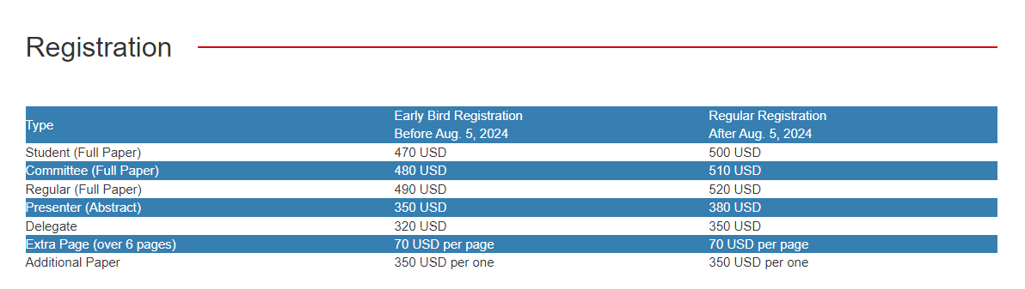
Paper registration (AIPE2024)

Slide 38
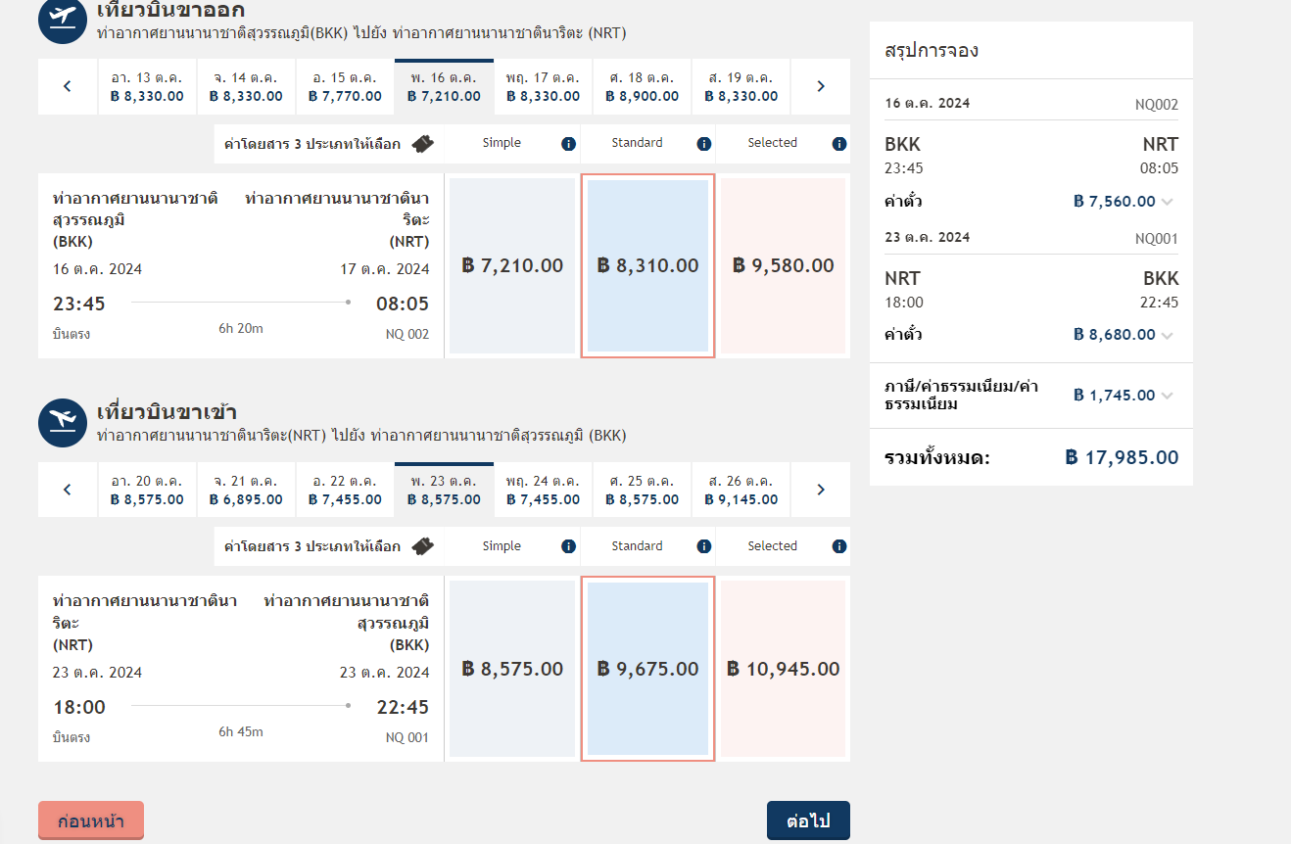
Plane Ticket (estimation case)

Slide 39
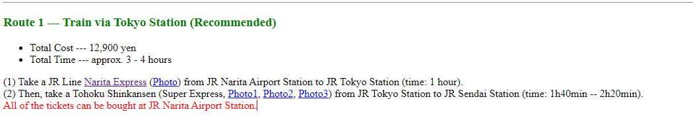
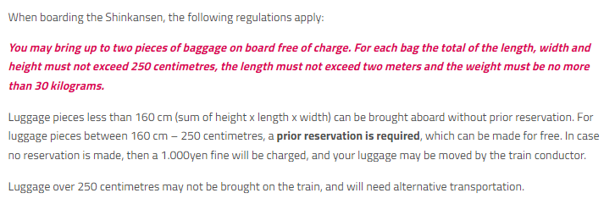
Train ticket

Slide 40
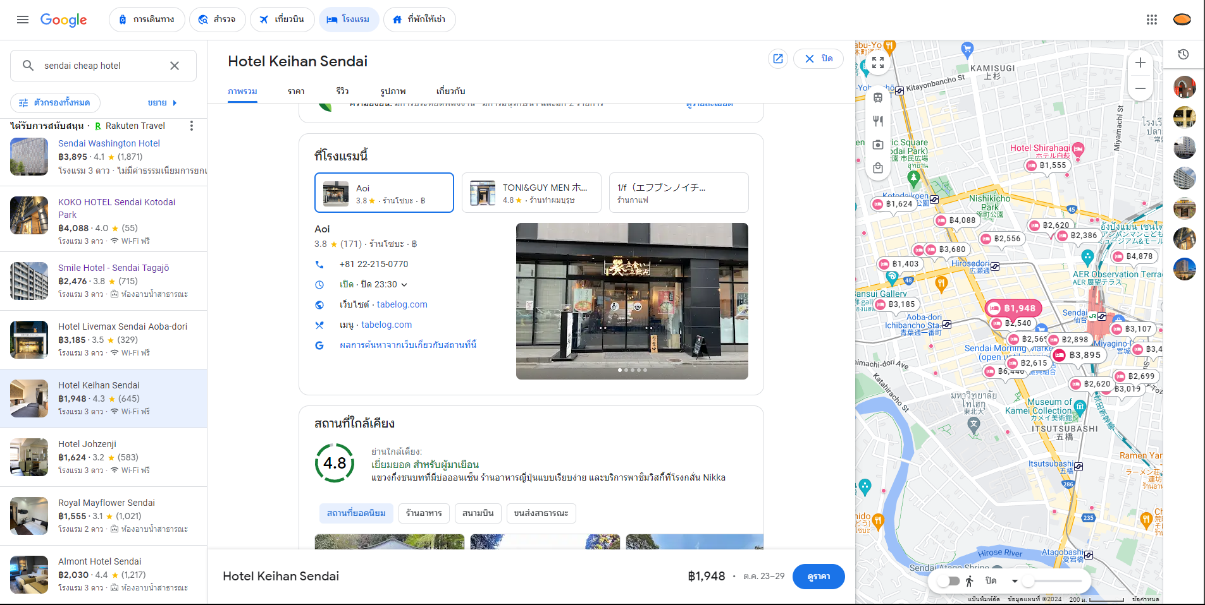
Accommodation
Note : Hotel price can go down more if we choose to use capsule hotel or other form of Accommodation, price may also differ

Slide 41
PC
PC with high compute power, big storage + a lot of VRAMs
Required 1 to 2 PCs

Slide 42
List | Price
Paper registration (AIPE2024) | 470USD (Early bird before Aug 5th) / 500 USD (After Aug 5th)
Plane ticket (BKK – NRT air Japan)* | 18,000 THB/ person (include 23kg with loaded luggage)
Train ticket (NRT - Sendai) | 12,900 yen / person (3,102 THB)
Accommodation (Hotel Keihan Sendai)** | 10,000 THB / 5night / 2people
PC (For model computation and simulation) | Borrow a few from storage for cluster computing
Total | ~ 42,905 THB / person (case each of everyone register to paper) ~ 26,102 THB / person (case not include paper registration) ~ 30,303 THB / person (case registration fee divided by 4)

Slide 43
*Plane ticket is dependent on the time of reservation if it's ~6 month prior to the flight date it'll be cheaper
**Close to Tohoku University City Campus the hotel place can be further to reduce the price

Slide 44
Future work
Potential Expansions: If the project scope allows, traffic flow analysis may be extended to:
Identifying optimal detour routes around the intersection during periods of severe congestion or incidents.
Coordination with traffic lights at neighboring intersections to optimize overall traffic flow in the area.

